Slide 1
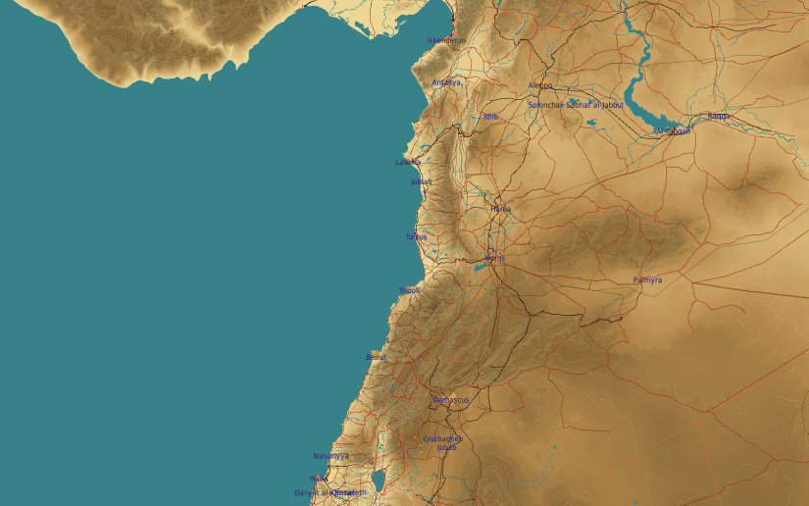
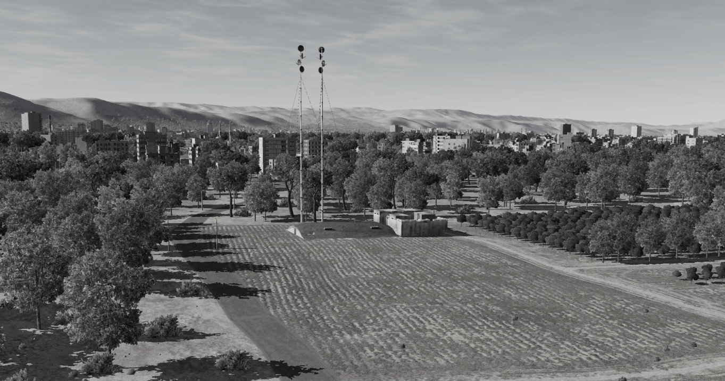
OPARTGT066 Syrian ADCC
N
66
1
DESCRIPTION OF THE DESIRED POINTS OF IMPACT WITH WPN TYPE:
OPARTGT066A – Syrian ADCC
DPI 1 N33 28.702 E036 17.716/2215ft/(2000 Ibs bomb)
OPARTGT066A– Hardened concrete bunker covered with approximately 2 meters of earth. Delayed fusing required to penetrate earth, crack concrete and affect structure integrity and contents.
Syrian ADCC
4
5
6
Residential areas in all directions from the facility within 200m.
7
8

